Slide 1

Category Review : Chips
Real Analytics
JUNE 2020

Slide 2
Our 17 year history assures best practice in privacy, security and the ethical use of data
We all have a responsibility to use data for good
Quantium believes in using data for progress, with great care and responsibility. As such please respect the commercial in confidence nature of this document.
Privacy Security Ethical Use
We have built our Business We are ISO27001 certified Applies to all our facets of our
Based on privacy by design internationally recognised for work, from the initiatives we take
principles for the past 17 our ability to uphold best on, the information we use and
Years practice standards across how our solutions impact our
Quantium has strict information security, individuals, organizations and
Protocols around the We use ‘bank grade’ security society.
Receipt and storage of to store and process data.
Personal information Comply with 200+ security
All information is requirements from NAB, Wool
De-identified using -worths and other data
an irreversible tokenisation partners.
Process with no ability to All partner data is held in
re -identify individuals separate restricted environm-
Ents
All access to partner data is
Limited to essential staff only
Security environment and
Processes regularly audited
by our data partners

Slide 3
Task 1
Here you will include your high level findings and any key callouts for task 1
Task 2
Here you will include your high level findings and any key callouts
for task 2

Slide 4
Category
1 1

Slide 5
Overview
Sales have mainly been due to Budget - older families, Mainstream young singles/couples, and Mainstream - retirees shoppers. We found that the high spend in chips for mainstream young singles/couples and retirees is due to there being more of them than other buyers. Mainstream, midage and young singles and couples are also more likely to pay more per packet of chips. This is indicative of impulse buying behaviour.
We’ve also found that Mainstream young singles and couples are 23% more likely to purchase Tyrrells chips compared to the rest of the population. The Category Manager may want to increase the category’s performance by off-locating some Tyrrells and smaller packs of chips in discretionary space near segments where young singles and couples frequent more often to increase visibility and impulse behaviour.
Quantium can help the Category Manager with recommendations of where these segments are and further help them with measuring the impact of the changed placement.

Slide 6
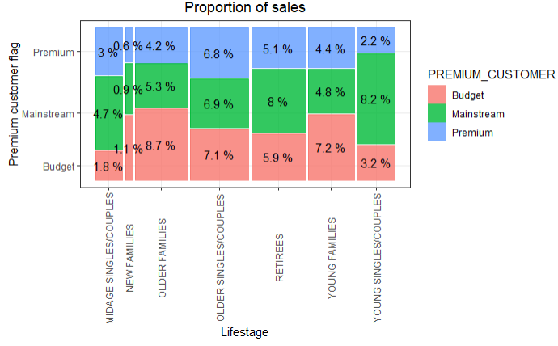
Affluence and its Effect on consumer buying for the category of chips

Slide 7
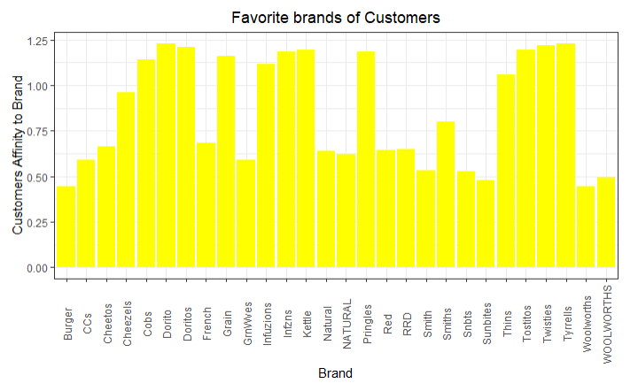

Slide 8
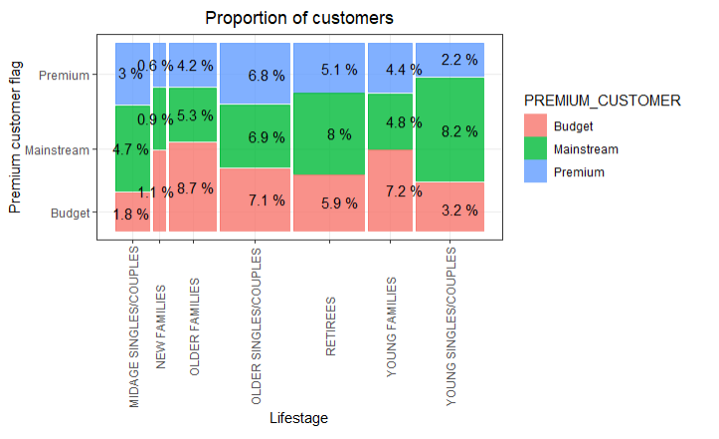
Proportion of Customers by Affluence and Life Stage

Slide 9
Trial Store Performance
2

Slide 10
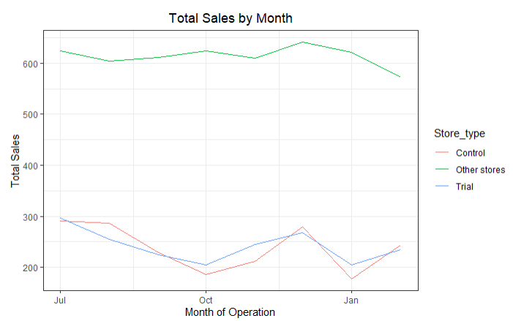
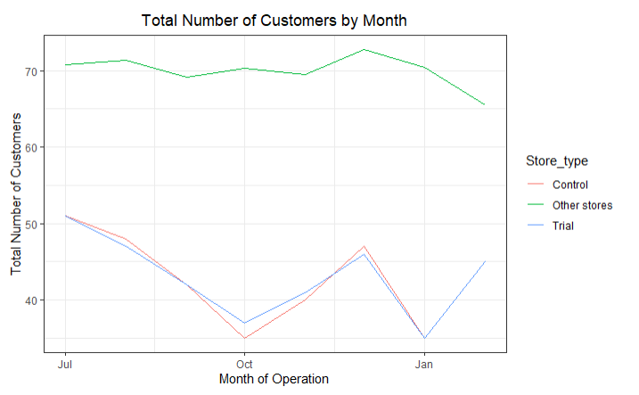
Control Store Vs Other Stores

Slide 11
